Slide 1
Programming with
Semaphore and Mutex
Contents: Semaphore and Mutex Functions

Slide 2
Background
  Processes can execute concurrently
    May be interrupted at any time, partially completing execution
  Concurrent access to shared data may result in data inconsistency
  Maintaining data consistency requires mechanisms to ensure the orderly execution of cooperating processes

Slide 3
Critical Section Problem
  Consider system of n processes { P0 , P1 , …, Pn-1 }
  Each process has a critical section segment of code
    Process may be changing common variables, updating table, writing file, etc.
    When one process is in its critical section, no other may be executing in its critical section
  Critical-section problem is to design a protocol to solve this
  Each process must ask permission to enter its critical section in entry section, may follow critical section with exit section, the remaining code is in its remainder section

Slide 4

Critical Section Problem

Slide 5
Synchronization Primitives
  Counting Semaphores
    Permit a limited number of threads to execute a section of the code
  Binary Semaphores - Mutexes
    Permit only one thread to execute a section of the code
  Condition Variables
    Communicate information about the state of shared data

Slide 6
POSIX
  Named Semaphores
    Provides synchronization between unrelated process and related process as well as between threads
    Uses sem_open
  Unnamed Semaphores
    Provides synchronization between threads and between related processes
    Thread-shared or process-shared
    Uses sem_init

Slide 7
POSIX Semaphores
  Data type
    Semaphore is a variable of type sem_t
  include <semaphore.h>
  Atomic Operations
    int sem_init(sem_t *sem, int pshared, unsigned value);
    int sem_destroy(sem_t *sem);
    int sem_post(sem_t *sem);
    int sem_trywait(sem_t *sem);
    int sem_wait(sem_t *sem);

Slide 8
Unnamed Semaphores
  #include <semaphore.h>
  int sem_init(sem_t *sem, int pshared, unsigned value);
  Returns 0 on success -1 on failure, sets errno
  Parameters
    sem: Target semaphore
    pshared: 0: only threads of the creating process can use the semaphore , Non-0: other processes can use the semaphore value:
    Initial value of the semaphore

Slide 9
Unnamed Semaphores
  Sharing semaphores between threads within a process is easy, use pshared==0
  A non-zero pshared allows any process that can access the semaphore to use it
    Places the semaphore in the global (OS) environment
    Forking a process creates copies of any semaphore it has
    Unnamed semaphores are not shared across unrelated processes

Slide 10
sem_init() can fail
  On failure
  sem_init returns -1 and sets errno
  sem_t semA;
  if (sem_init(&semA, 0, 1) == -1)
  perror(“Failed to initialize semaphore semA”);
errno
cause
EINVAL
ENOSPC
EPERM
Value > sem_value_max
Resources exhausted
Insufficient privileges

Slide 11
Semaphore Operations
  int sem_destroy(sem_t *sem);
    Destroy an semaphore
  Returns - 0 on success , -1 on failure, sets errno
  Parameters
    sem: Target semaphore
    Can destroy a sem_t only once
    Destroying a destroyed semaphore gives undefined results
    Destroying a semaphore on which a thread is blocked gives undefined results

Slide 12
Semaphore Operations
  int sem_post(sem_t *sem);
    Unlock a semaphore - same as signal
  Returns - 0 on success, -1 on failure, sets errno (== EINVAL if semaphore doesn’t exist)
  Parameters
    sem: Target semaphore
    sem > 0: no threads were blocked on this semaphore, the semaphore value is incremented
    sem == 0: one blocked thread will be allowed to run

Slide 13
Semaphore Operations
  int sem_wait(sem_t *sem);
    Lock a semaphore
  Blocks if semaphore value is zero
  Returns - 0 on success, -1 on failure, sets errno (== EINTR if interrupted by a signal)
  Parameters
    sem: Target semaphore
    sem > 0: thread acquires lock
    sem == 0: thread blocks

Slide 14
Semaphore Operations
  int sem_trywait(sem_t *sem);
    Test a semaphore’s current condition
    Does not block
  Returns - 0 on success, -1 on failure, sets errno (== AGAIN if semaphore already locked)
  Parameters
    sem: Target semaphore
    sem > 0: thread acquires lock
    sem == 0: thread returns

Slide 15
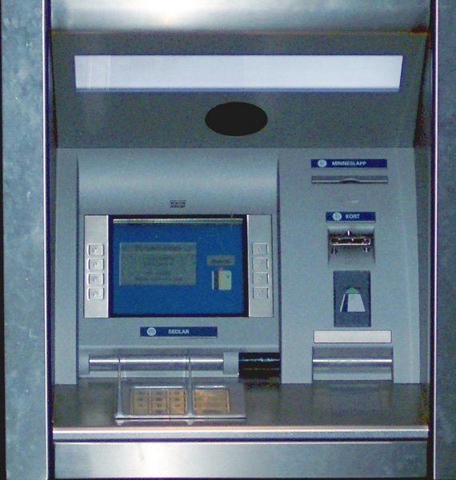
Example: bank balance
Protect shared variable balance with a semaphore when used in:
  decshared
    Decrements current value of balance
  incshared
    increments the balance

Slide 16
Example: bank balance
int decshared() {
while (sem_wait(&balance_sem) == -1)
if (errno != EINTR)
return -1;
balance--;
return sem_post(&balance_sem);
}
int incshared() {
while (sem_wait(&balance_sem) == -1)
if (errno != EINTR)
return -1;
balance++;
return sem_post(&balance_sem);
}

Slide 17
Example: bank balance
int decshared() {
sem_wait(&balance_sem)
balance--;
sem_post(&balance_sem);
}
int incshared() {
sem_wait(&balance_sem)
balance++;
sem_post(&balance_sem);
}

Slide 18

Example: bank balance
#include <errno.h>
#include <semaphore.h>
static int balance = 0;
static sem_t bal_sem;
int initshared(int val) {
if (sem_init(&bal_sem, 0, 1) == -1)
return -1;
balance = val;
return 0;
}
pshared
value

Slide 19
Example: bank balance
int decshared() {
while (sem_wait(&bal_sem)
== -1)
if (errno != EINTR)
return -1;
balance--;
return sem_post(&bal_sem);
}
int incshared() {
while (sem_wait(&bal_sem)
== -1)
if (errno != EINTR)
return -1;
balance++;
return sem_post(&bal_sem);
}

Slide 20
Advanced Semaphores
int semget(key_t key, int nsems, int semflg);
Get set of semaphores
int semop(int semid, struct sembuf *sops, unsigned int nsops);
Atomically perform a user-defined array of semaphore operations on the set of semaphores

Slide 21
Pthread Synchronization
Two primitives
  Mutex
    Semaphore with maximum value 1
  Condition variable
    Provides a shared signal
    Combined with a mutex for synchronization

Slide 22
Pthread Mutex
States
  Locked
    Some thread holds the mutex
  Unlocked
    No thread holds the mutex
When several threads compete
  One wins
  The rest block
    Queue of blocked threads

Slide 23
Mutex Variables
A typical sequence in the use of a mutex
  Create and initialize mutex
  Several threads attempt to lock mutex
  Only one succeeds and now owns mutex
  The owner performs some set of actions
  The owner unlocks mutex
  Another thread acquires mutex and repeats the process
  Finally mutex is destroyed

Slide 24
Creating a mutex
int pthread_mutex_init(pthread_mutex_t *mutex, const pthread_mutexattr_t *attr);
Initialize a pthread mutex: the mutex is initially unlocked
Returns
  0 on success
  Error number on failure
    EAGAIN: The system lacked the necessary resources; ENOMEM: Insufficient memory ; EPERM: Caller does not have privileges; EBUSY: An attempt to re-initialise a mutex; EINVAL: The value specified by attr is invalid
Parameters
  mutex: Target mutex
  attr:
    NULL: the default mutex attributes are used
    Non-NULL: initializes with specified attributes

Slide 25
Creating a mutex
Default attributes
  Use PTHREAD_MUTEX_INITIALIZER
    Statically allocated
    Equivalent to dynamic initialization by a call to pthread_mutex_init() with parameter attr specified as NULL
    No error checks are performed

Slide 26
Destroying a mutex
#include <pthread.h>
int pthread_mutex_destroy(pthread_mutex_t *mutex);
Destroy a pthread mutex
Returns
  0 on success
  Error number on failure
    EBUSY: An attempt to re-initialise a mutex; EINVAL: The value specified by attr is invalid
Parameters
  mutex: Target mutex

Slide 27
Locking/unlocking a mutex
#include <pthread.h>
int pthread_mutex_lock(pthread_mutex_t *mutex);
int pthread_mutex_trylock(pthread_mutex_t *mutex);
int pthread_mutex_unlock(pthread_mutex_t *mutex);
Returns
  0 on success
  Error number on failure
    EBUSY: already locked; EINVAL: Not an initialised mutex; EDEADLK: The current thread already owns the mutex; EPERM: The current thread does not own the mutex

Slide 28
Simple Example
#include <pthread.h>
#include <stdio.h>
#include <stdlib.h>
static pthread_mutex_t my_lock = PTHREAD_MUTEX_INITIALIZER;
void *mythread(void *ptr) {
long int i,j;
while (1) {
pthread_mutex_lock (&my_lock);
for (i=0; i<10; i++) {
printf ("Thread %d\n", int) ptr);
for (j=0; j<50000000; j++);
}
pthread_mutex_unlock (&my_lock);
for (j=0; j<50000000; j++);
}
}
int main (int argc, char *argv[]) {
pthread_t thread[2];
pthread_create(&thread[0], NULL, mythread, (void *)0);
pthread_create(&thread[1], NULL, mythread, (void *)1);
getchar();
}

Slide 29
Condition Variables
Used to communicate information about the state of shared data
  Execution of code depends on the state of
    A data structure or
    Another running thread
Allows threads to synchronize based upon the actual value of data
Without condition variables
  Threads continually poll to check if the condition is met

Slide 30
Condition Variables
Signaling, not mutual exclusion
  A mutex is needed to synchronize access to the shared data
Each condition variable is associated with a single mutex
  Wait atomically unlocks the mutex and blocks the thread
  Signal awakens a blocked thread

Slide 31
Creating a Condition Variable
Similar to pthread mutexes
int pthread_cond_init(pthread_cond_t *cond, const pthread_condattr_t *attr);
int pthread_cond_destroy(pthread_cond_t *cond);
pthread_cond_t cond = PTHREAD_COND_INITIALIZER;

Slide 32
Using a Condition Variable
Waiting
  Block on a condition variable.
  Called with mutex locked by the calling thread
  Atomically release mutex and cause the calling thread to block on the condition variable
  On return, mutex is locked again
int pthread_cond_wait(pthread_cond_t *cond, pthread_mutex_t *mutex);
int pthread_cond_timedwait(pthread_cond_t *cond, pthread_mutex_t *mutex, const struct timespec *abstime);

Slide 33
Using a Condition Variable
Signaling
int pthread_cond_signal(pthread_cond_t *cond);
  unblocks at least one of the blocked threads
int pthread_cond_broadcast(pthread_cond_t *cond);
  unblocks all of the blocked threads
Signals are not saved
  Must have a thread waiting for the signal or it will be lost

Slide 34
Condition Variable
pthread_mutex_lock(&mutex); /* lock mutex */
while (!predicate) { /* check predicate */
pthread_cond_wait(&condvar, &mutex);
/* go to sleep – recheck
pred on awakening */
}
pthread_mutex_unlock(&mutex); /* unlock mutex */
pthread_mutex_lock(&mutex); /* lock the mutex */
predicate=1; /* set the predicate */
pthread_cond_broadcast(&condvar); /* wake everyone up */
pthread_mutex_unlock(&mutex); /* unlock the mutex */

Slide 35
Condition Variable: No mutex!
pthread_mutex_lock(&mutex); /* lock mutex */
while (!predicate) { /* check predicate */
pthread_mutex_unlock(&mutex); /* unlock mutex */
pthread_cond_wait(&condvar); /* go to sleep – recheck
pred on awakening */
pthread_mutex_lock(&mutex); /* lock mutex */
}
pthread_mutex_unlock(&mutex); /* unlock mutex */
pthread_mutex_lock(&mutex); /* lock the mutex */
predicate=1; /* set the predicate */
pthread_cond_broadcast(&condvar); /* wake everyone up */
pthread_mutex_unlock(&mutex); /* unlock the mutex */

Slide 36
Revision
  Semaphore Programming
  Mutex Programming
    Ass No 04: Producer consumer Problem
    Ass No 05: Reader Writer Problem
    Ass No 06: Dinning Philosopher Problem

Slide 37
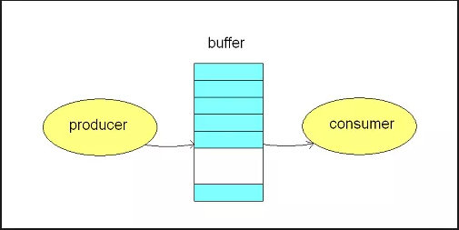
Producer Consumer Problem

Slide 38
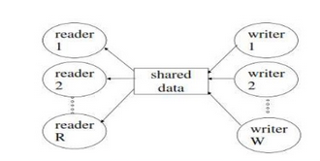
Reader Writer Problem

Slide 39
Reader Writer Problem
  There is a data area shared among a number of processes.
  There are a number of processes that only read the data and a number that only write to the data area.
  Any number of readers may simultaneously read the file
  Only one writer at a time may write to the file
  If a writer is writing to the file, no reader may read it

Slide 40
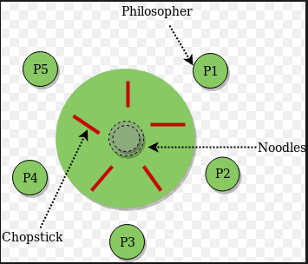
Dinning Philosopher Problem

